Slide 1


Categories of Overlapping Duties
Contractual
 | CONTRACTUAL
SCOPE | MBIE enters contractual relationships for contracts of service, bespoke pieces of work, tenders, projects. These contractual relationships bring multiple PCBU’s together in a time-bound relationship that requires consultation, cooperation, and coordination together to manage health and safety (Section 34, HSWA 2015)
MBIE’S PCBU OVERLAPPING DUTIES ACTIVITIES (e.g.) | Capital works Service contracts Large projects (e.g., Tui decommissioning, NZ Battery).
KEY INTERNAL RELATIONSHIPS | Procurement Team Projects Team WHS Team Legal
COMPLIANCE | Site Specific Safety Plans Induction Monitoring and Review
MONITORING/ REPORTING | Develop a monitoring and reporting process that includes – incident investigations, escalation points, spot checks, dashboard analytics.
COMPLIANCE ASSURANCE MATRIX DEVELOPED IN FOUR STEPS:
Identify PCBU relationships Identify the overlapping duty responsibilities Monitoring the overlapping duty activities Review the PCBU relationships and activities

Slide 2
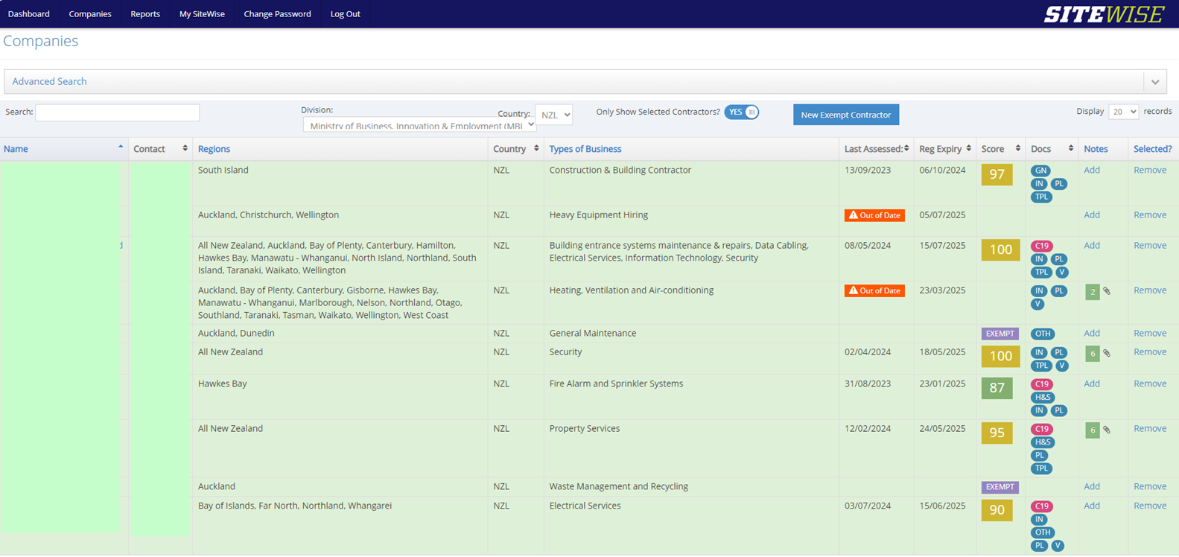
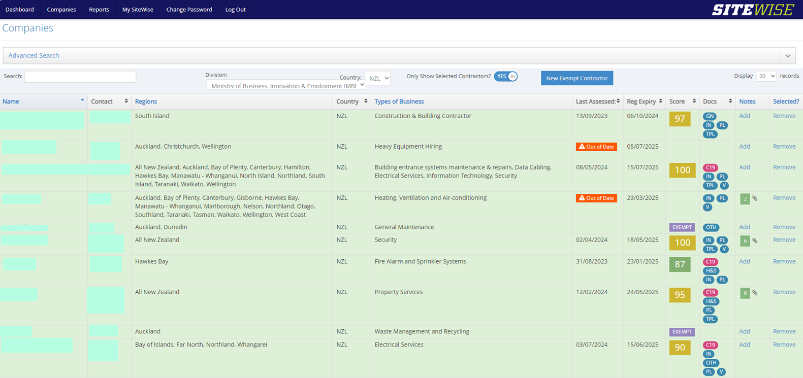
Categories of Overlapping Duties
Contractual

Slide 3
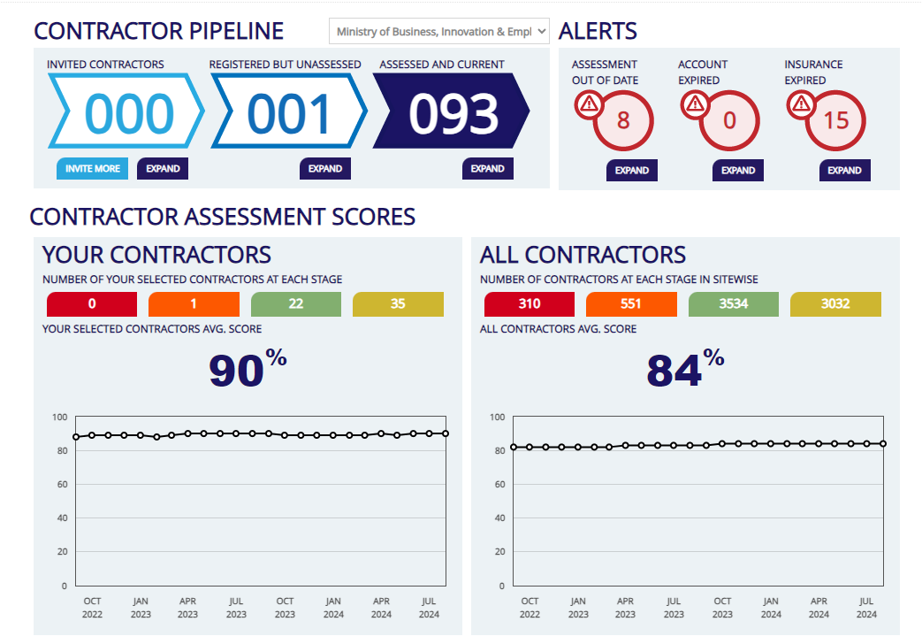
Categories of Overlapping Duties
Contractual

